Slide 1
Module 31: Extending the Siebel Database
Siebel Core Developer and Technology School
Notes:
Time: Lecture: 25 – 35 minutes; labs: 75 – 100 minutes
Intent: To show how the database can be extended to support storing additional fields and business components.
Flow: The need for database extension, extending the database, adding a new column, creating a new standalone table, creating a new 1:1 extension table, creating a new 1:M extension table, and creating a new intersection table.
Key Terms:
Extension column
Standalone table
Applying
Table wizard
Please note: Faculty-specific notes are italicized.

Slide 2

Module Objectives
After completing this module you will be able to:
  Create extension columns in a table
  Create custom tables
    Standalone table
    1:1 extension table
    1:M extension table
    Intersection table
Why you need to know:
  Enables you to incorporate additional attributes and business entities into a Siebel application

Slide 3
Incorporating Additional Data
Your business requirements may include:
  Adding new fields to capture additional data
  Creating new business components to capture additional business entities
Extending the Siebel database can satisfy these requirements
  Adding one or more columns to an existing table
  Creating new database tables to support new business components
Notes:
This slide provides motivation for adding new fields and business components. One way to satisfy these business requirements is to extend the Siebel Data Model by either adding new columns to an existing table or creating a new table.

Slide 4
Evaluate the Existing Database Tables
Prior to extending the Siebel database, consider using:
  Unused columns in an existing table
  Existing 1:M extension table
Notes:
Changing the schema has many consequences and does require more work than just changing the configuration. Therefore, the first step is to examine if existing tables and business components can meet your business requirements. In the following slides, we examine two approaches.

Slide 5
Unused Columns in an Existing Table
Consider mapping new fields to unused columns in an existing base or 1:1 extension table
  Verify that candidate column has the desired type
  Consider possible upgrade conflicts in future releases
  Consider performance impact of a join to the 1:1 extension table
Notes:
The first approach is to check for a column in an existing base or extension table. It’s important to make sure that no other business component uses that column before they start to use it. The risk that Siebel Engineering may choose to use that column (especially if it is in the base table) in a subsequent release.

Slide 6
Existing 1:M Extension Tables
Consider mapping the new business component to an appropriate 1:M extension table
  Verify that the business component has the correct relationship to the candidate parent business component
Notes:
The second approach is to possibly use an existing 1:M extension table. This is a common approach when you need to create a new business component that has a 1:M relationship with a standard Siebel-delivered business component.

Slide 7
Using Siebel Tools to Extend the Database
Supports creating new:
  Extension columns on tables
  Standalone tables
  1:1 extension tables
  1:M extension tables
  Intersection tables
Creates new object definitions for the database extension
  Invokes wizard to build new tables
Makes the corresponding physical database changes
  Developers do not create, use, or maintain SQL scripts
Notes:
Once we have found that no existing columns/tables can be used, we would then consider changing the database schema. The new columns are created manually. The new tables are created via a wizard.

Slide 8
Extending the Database
Changes database schema and requires propagating changes to:
  Other developers during development
  Mobile users after development for applications in production
Requires creating additional object definitions to:
  Map columns in the EIM tables needed to import and export data to the extension columns and tables
  Specify how data for these extension columns and tables are to be routed to remote users (Dock Objects)
Notes:
This slide mentions the very important point that changing the database schema has consequences that require additional effort. Not only do we need to ensure that changes are propagated to all users, but we need to make the appropriate changes to EIM and Dock Objects.

Slide 9
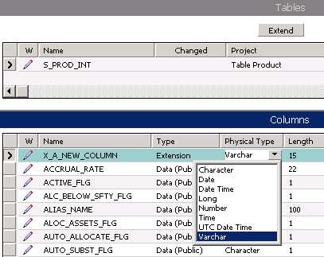
Creating a Custom Extension Column
Make logical changes to the Data layer
  Check out the appropriate project
  Select table to be extended
  Create a new column record with the desired properties
    Name automatically prefixed with X_
Notes:
This slide shows how to add a new column to an existing table. This is performed by manual configuration.
The Siebel Tools will automatically add an X_ to the beginning of the column name you enter.

Slide 10
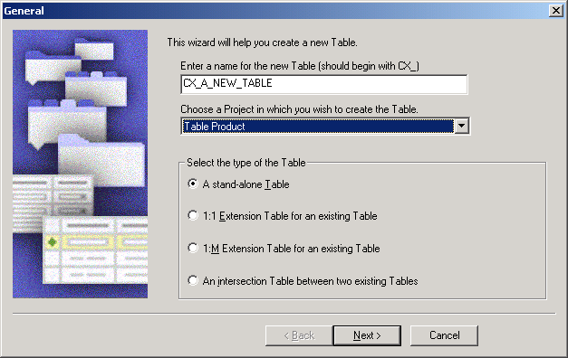
Creating a New Table
Use the Table wizard to create a new table
  Select File > New Object > Table
Notes:
Tables are created using a Table wizard. There are four types of tables that can be created. The wizard only makes the logical changes in Siebel Tools; it does not apply the physical database changes.

Slide 11
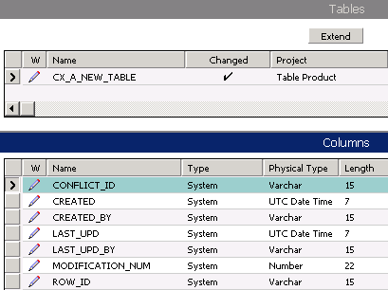
Creating a Standalone Table
Table wizard creates a standalone table with:
  Type of Data (Public)
  Seven system columns
Notes:
This slide shows how to create a new standalone table using the Table wizard. The standard set of system columns are also created and the table is ready for the user to add the necessary set of user columns.

Slide 12
Creating a 1:1 Extension Table
Select a base table
  Choice restricted to type Data (Public)
  Multiple extension tables relate directly to base table, and not to each other
S_PROD_INT
CX_PROD_INT_X
ROW_ID
NAME
PART_NUM
UOM_CD
ROW_ID
NEW COLUMN
PAR_ROW_ID
Notes:
This slide shows the requirements for creating a 1:1 extension table. Note that you cannot create extension tables for S_CONTACT and S_ORG_EXT because they are already extension tables. However, you can create additional extension tables for S_PARTY.

Slide 13
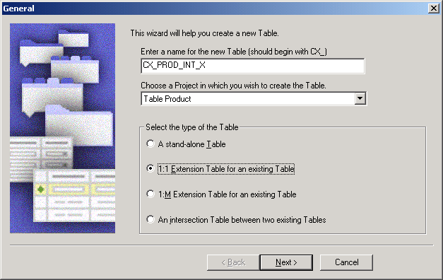
Creating a 1:1 Extension Table Continued
Table wizard creates an extension table with:
  Seven system columns
  PAR_ROW_ID column as foreign key column to base table
  P1 index on ROW_ID
  U1 index on PAR_ROW_ID and CONFLICT_ID
Notes:
This slide shows how to create a new 1:1 extension table using the Table wizard. The standard set of system columns are also created.
1:1 extension tables also need a PAR_ROW_ID column and a user index created on PAR_ROW_ID and CONFLICT_ID. The primary index based on ROW_ID is also created.
This may be a good place to remind students what the seven system columns are, and how to view them in the UI by selecting Help > About Record. Also show them in Tools that all tables have these 7 columns regardless of the type of table.
The seven system columns are:
Created by
Created by ID
Modified
Modified by
Row Id
Conflict Id

Slide 14
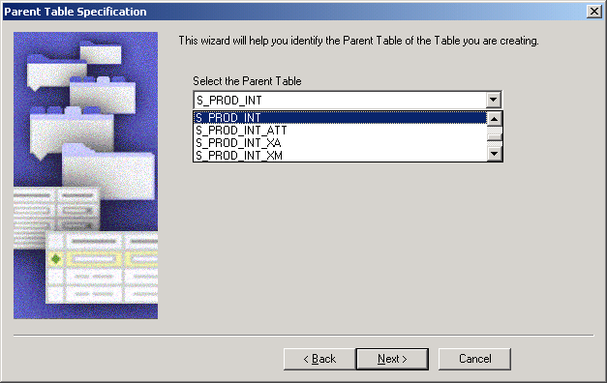
Creating a 1:M Extension Table
Select a parent table
  Choice restricted to type Data (Public)

Slide 15
Creating a 1:M Extension Table Continued
Table wizard creates an 1:M extension table with:
  Seven system columns
  PAR_ROW_ID column as foreign key column to base table
  TYPE and NAME columns
  Type of Data(Public)
  P1 index on ROW_ID
  U1 index on PAR_ROW_ID, TYPE, NAME, and CONFLICT_ID
  M1 index on TYPE and NAME
Notes:
This slide lists the additional columns and indexes created to support the 1:M table requirements.

Slide 16
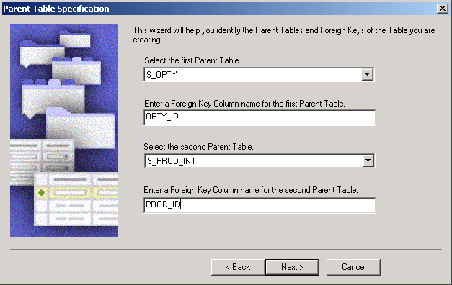
Creating an Intersection Table
Select both parent tables
  Choices restricted to type Data(Public)
Specify the foreign key column name for each parent table
Notes:
This slide shows how to use the wizard to create a new intersection table. Both parent tables must be of type Public and the wizard enforces that by only showing such tables in the picklists.

Slide 17
Creating an Intersection Table Continued
Table wizard creates an intersection table with:
  Seven system columns
  Two foreign key columns as specified
  Type of Data(Intersection)
  P1 index on ROW_ID
  U1 index on two foreign key columns, TYPE, and CONFLICT_ID
  F1 index on foreign key to second parent table
Notes:
This slide lists the columns and indexes that the wizard creates.

Slide 18
Applying and Propagating Database Changes
Test changes locally before applying to the server database
  Reduces the likelihood of undesired changes to the server schema
Best practices for changing the schema
  Apply changes to local database
  Propagate changes to server database
  Propagate changes to other developers

Slide 19
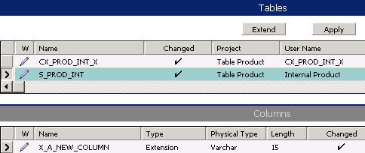
Apply Changes to Local Database
Click Apply to make the physical database changes
  All database schema changes are made by Siebel Tools
  No separate SQL scripts need to be created or maintained
  Changes are preserved across Siebel application upgrades
Compile relevant projects
Test changes locally before checking projects into server
  Use vendor-supplied utility to query extended tables
Notes:
We need to use the Apply button to apply the change to the database. The Activate button is used to increment the database schema number after we have applied changes. Stress that Siebel Tools actually makes all the changes to the database; the user does not.

Slide 20


Propagate Changes to Server Database
Check project into the server
  Copies the table and column object definitions
  Does not apply those changes to the server database schema
Apply changes to the server database
Compile and test against the server database
Server Machine
Developer Workstation
Developer Workstation
Developer Workstation
Apply
Check in
Notes:
To apply changes to the server database, log in to Siebel Tools, connecting to the server data source, and click the Apply button as described in the previous slide.

Slide 21
Propagate Changes to Other Developers
Other developers need to apply changes to their local databases
  Have other developers get or check out the project and apply changes locally
  Alternatively re-extract developers and have them get all projects
Server Machine
Developer Workstation
Developer Workstation
Developer Workstation
Get/
Check out
Get/
Check out
Notes:
This slide mentions that because the database schema has been changed you will need to make the same changes to all other copies within your environment.

Slide 22
Summary
This module showed you how to:
  Create extension columns in a table
  Create custom tables
    Standalone table
    1:1 extension table
    1:M extension table
    Intersection table
Notes:
Review Question: What database changes can you make directly by configuration?
Answer: Add a new column to an existing table.
Review Question: What are the types of tables that the Table wizard can create?
Answer: Standalone table, 1:1 extension table, 1:M extension table, intersection table.

Slide 23
Lab
In the lab you will:
  Add custom extension columns to a table
  Reference the custom extension columns and display them on a list applet
  Transfer the modified configuration to the server
Notes:
See the lab instructions for more details.
Troubleshooting:
Lab 31-3 step 9b: Students may notice that their Siebel Server name is Siebel_SUSrvr, not siebel_<machine name> as the lab states. This will be corrected in the next release.
Please note: There are not solution documents for labs 31-2 and 31-3.

